Slide 1

Build Your Ecosystem
Cory.Klatik@Microsoft.com
@CKLATIK & in/CKLATIK

Slide 2
Purpose
Explore ways to judge off the shelf tools and resources for the most accessible outcome

Slide 3
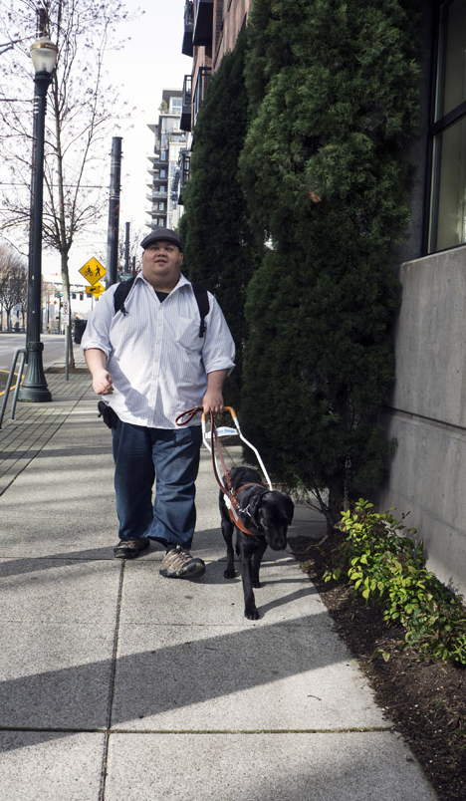
Who?
Microsoft Design Engineer building enterprise experiences that are accessible and usable for everyone
Started in UX as front-end developer then shifted to accessibility & usability
Before that spent 5 years leading social media programs for Intel on data center technology
Yes, Vine is obnoxiously cute.
She is 7 and I have had her for 5 years.

Slide 4
Understand
Nothing advertised as plug and play accessible is accessible without some changes
To build accessible you must choose accessible and think accessible
To deliver a great experience you must strive for a great experience at every stage of the development and design lifecycle

Slide 5

Don’t be that team

Slide 6
The Landscape
Altinn Design System
Angular
Ant-design
Atlassian Design Language
Audi UI
Aurelia
Backpack
Base
Bloom
Bootstrap
Brainly Style Guide
Brand Estonia
Canvas
Carbon
Cedar
CFPB Design Manual
CF-UI
Chameleon
Clarity Design System
CNVS
Django
Drupal
Duo Design Standards
Ember
Fabric
Feelix
Fluent
Flutter
Foundation
Frontier
Fuse
GEL
GLU
Grommet
Harmony
Hedwig
Jade
JetBrains Web UI
Joomla
jQuery
Lexicon
Lightning
Magento
Magnolia
Material-UI
Metal.js
Mineral UI
Morningstar Design System
Nachos
Opattern
OpenAQ Design System
Origami
Photon Design System
Pivotal UI
plasma
Pluralsight Design System
Polaris
Polymer
Predix Design System
Priceline Design System
Primer
Purple3
React
Rizzo
Royal Canin’s Design Language
Scooter
Semantic UI
Solid
Spark Design System
Stacks
Starling
Svelte
Swarm Design System
U.S. Web Design System
USA Jobs Design System
uStyle
Vue
Wonderbly Design System
WordPress
Wordpress.com Design Handbook
Notes:
Sources: Stack Overflow and adele.uxpin.com

Slide 7
The Accessible Landscape
Altinn Design System
Angular
Ant-design
Atlassian Design Language
Audi UI
Aurelia
Backpack
Base
Bloom
Bootstrap
Brainly Style Guide
Brand Estonia
Canvas
Carbon
Cedar
CFPB Design Manual
CF-UI
Chameleon
Clarity Design System
CNVS
Django
Drupal
Duo Design Standards
Ember
Fabric
Feelix
Fluent
Flutter
Foundation
Frontier
Fuse
GEL
GLU
Grommet
Harmony
Hedwig
Jade
JetBrains Web UI
Joomla
jQuery
Lexicon
Lightning
Magento
Magnolia
Material-UI
Metal.js
Mineral UI
Morningstar Design System
Nachos
Opattern
OpenAQ Design System
Origami
Photon Design System
Pivotal UI
Plasma
Pluralsight Design System
Polaris
Polymer
Predix Design System
Priceline Design System
Primer
Purple3
React
Rizzo
Royal Canin’s Design Language
Scooter
Semantic UI
Solid
Spark Design System
Stacks
Starling
Svelte
Swarm Design System
U.S. Web Design System
USA Jobs Design System
uStyle
Vue
Wonderbly Design System
WordPress
Wordpress.com Design Handbook
Notes:
Sources: Stack Overflow and adele.uxpin.com

Slide 8
The truth is a harsh reality

Slide 9

Let’s make magic

Slide 10
How do you figure this out?
Build your core objectives based on user’s objectives
Talk to your users first – build real-world personas and stories
Focus on building value for users first
Make POUR decisions
Ensure every aspect from mockup to prototype and beta is:
Perceivable
Operable
Understandable
Robust
Define & design for inclusive experiences
Business goals can't be achieved if users hate your application or cannot use it
Inclusive experiences benefit everyone
Make time for user feedback early so you can iterate

Slide 11








For example
Acme University wants to create a new course catalogue
The Registrar wants a fast catalogue that works on tablets, and is intelligent – They are funding the project
IT needs it to connect with an database built in 2004
The Board wants to track what courses students view the most
Marketing has new branding which sets your primary colors as light green, dark green, and black with Helvetica Light or Condensed as your type-faces
The student + IT team building the application are skilled in ‘vanilla’ JavaScript and a couple of other tools. They are proud of the “modern minimalist” style they have used previously
Students… They just want it to work and be up to date

Slide 12
Where to start?
Users. Start with the users…
What do students need from the catalogue?
How are they using it?
Where are they using it?
When are they using it?

Slide 13
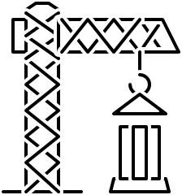
Ok… What about building this?
Grid for listing courses
Responsive layout
Ability match design & branding
Color customization capable
The catalogue page needs to fit in the existing content management system
What else?

Slide 14
Assumptions
Branding is locked in
Content Management system is Drupal
Header and footer for University are static and responsive already
IT has an API to connect to the Registrar’s database of classes
Our team will be focusing just on the catalogue itself

Slide 15
What we’re building at a minimum
Must be compliant to WCAG 2.0 AA
Table that can be searched, sorted, and filtered
Page that utilizes progressive enhancement and responsive layout to adapt to browser and device
Design that meets branding requirements

Slide 16
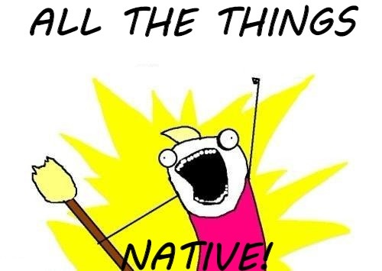
Our options – Native
Build native HTML table with controls that apply filtering to the table after the changes are applied
Most accessible out of the box experience
Most compatible with older browsers
Fastest to build for desktop
Requires time to build multiple versions of the table and page design for different sized screens
Presents challenges for adapting text size in between screen size choices
Least modern approach
Offers some design customizations

Slide 17
Our options – The Hybrid
Utilize native controls and update page content after the user applies changes but use a grid structure instead of a table to layout the data
Filtering and searching remain easily accessible
Faster development time for building the end to end experience
Allows for more style and design control of the data results
A more modern experience that can adapt to screen sizes
The grid may require adaptation to make accessible
Will still require some extra work to have controls’ layout adapt to different screen sizes and text sizes

Slide 18
Our options – The New Hotness
A grid that dynamically updates as the user searches for keywords and sets filters with no separate controls – A complete self contained solution in one place that resizes immediately to all screen sizes
Cutting edge solution that highlights technical capability
Offers the most options for customization
Can automatically adapt to screen size and text size
Offers modular code that can be embedded into other pages
May require extra work to make accessible and compliant
Browsers older than 2016 will require a different version

Slide 19
Which option?
Native
The Hybrid
The New Hotness

Slide 20
Nope… Not that simple
Native
The Hybrid
The New Hotness

Slide 21
The New Hybrid
Build the option that is the fastest to build to get user feedback as fast as possible then add functionality progressively to make the experience responsive and dynamic
Minimal work to ensure accessibility initially
Fastest time to user feedback ((TTUF?))
Update design, layout, and structure based on diverse user feedback
Deploy first version that meets minimum business requirements
Iterate from there

Slide 22
What about that grid?
While native HTML tables are the most accessible we’re looking at making this page as flexible as possible to how our users will be accessing the content this means looking at newer approaches to enabling that in a way that is doable for our student + IT team
Options –
Off the shelf, “plug and play” solution
Customize an open source solution
Build it from scratch

Slide 23
Our “off the shelf” options
Slickgrid
Datatables.net
ag-grid
Fancygrid
ui-grid
Sencha
Telerik
Vaadin
Jqwidgets
Flutter/DART Table

Slide 24
Evaluating
Can we customize it to our branding needs
Can our team feed it data from the database?
Does it meet our flexibility requirements?
Is it accessible?
Can we make it accessible?
How much does it cost?

Slide 25
Off-the-shelf grids that may work
Slickgrid - not accessible, work required is high
ag-grid – not accessible work required is high
Datatables.net – free and open source
Fancygrid – free and open source
ui-grid – Free and open source
Sencha – ‘accessible’ plug-in, very high cost
Telerik – minimal work required but high cost
Vaadin – free and open source
jqwidgets – accessible, but cost is high
Flutter/DART Table – not accessible out of the box

Slide 26
We have work to do…
Datatables.net – Can be made accessible out of the box, customizable to our needs
Fancy-grid – Not accessible out of the box, requires complete modification and has features we do not need like charting
ui-grid – Not accessible, open GitHub tickets since 2013
Vaadin – Advertised as OOB accessible, but has steep learning curve and performance requirements
DIY – Most customizable, steepest learning curve, and requires all accessibility to be hand coded

Slide 27
How did we get here?
Web search
GitHub search
Stack Overflow search
Once obvious blockers were identified examples/samples were manually tested and reviewed with automatic testing tools like AXE

Slide 28
So…?
Datatables.net – Strong community, existing libraries for Drupal, and works across multiple JavaScript tools
DIY – Gives the most control to the developers and IT for supportability
Vaadin – While it advertises an OOB accessible experience it requires a level of extra work to fit into an existing page that make it less desirable

Slide 29
Other considerations
Color scheme for filter and search controls
Color and font for tabular data
Simplifying information presentation
Load and performance testing
Do we need a low-bandwidth option?
What else would we need to consider?

Slide 30
Shift your work and your mindset left
To succeed designers must deliver proposals that are created for all personas, developers have to build applications with accessibility integrated into every feature or story, and it is essential that business and/or engineering program managers define requirements that place end-users first.
Currently
Accessibility “feature” built or exposed as absent
Define
Design
Develop
Test
Deploy
Maintain

Slide 31
Analyze & Criticize
Judge each requirement, feature, and design from multiple perspectives
Better yet talk to as many users as possible before defining requirements
Iterate quickly to something that is usable and accessible before publishing anything so that you can collect feedback on a legitimate experience
Fail fast, but fail forward.

Slide 32
Less technical more cultural
Every stake-holder, creator, developer, manager, leader, tester, editor, janitor, etc. need to be expected to participate, deliver, and require the same of others
This isn’t a tops-down or grass-roots effort, mindset and cultural change has to come from every level
No one can ‘just’ follow guidelines or take orders

Slide 33
Wrap-up
Slides are at https://aka.ms/ckcsun18
E-mail me at Cory.Klatik@microsoft.com
Twitter @CKLATIK

Slide 34
Recommended Web Reading
Inclusive Design at Microsoft
User Centered Design @ usability.gov
UW Primer on Universal Design
Build Personas for your users
Inclusive Design Principles
Inclusive Components for Web
Office UI Fabric

Slide 35
Recommended Books
Don't Make Me Think, Revisited by Krug
Inclusive Design Patterns by Pickering
Design for Real Life by Meyer, Wachter-Boettcher
Including Your Missing 20% by Hassell
A Web for Everyone by by Horton, Quesenbery,‎ Gustafson
Lean UX by Gothelf
The Design of Everyday Things by Norman
Quantifying the User Experience by Sauro, Lewis
The Persona Lifecycle by Pruitt, Adlin
User Story Mapping by Patton

